Slide 1
Key Stage 3 English
Essentially, KS3 and 4 are one key-stage
English Language - a skills-driven subject.
Reading to understanding, synthesise, analyse and evaluate writers’ methods.
Writing to describe, narrate like a novelist … and to write to present a point of view like a journalist.
English Literature – skills and knowledge driven
Appreciation of the writer’s craft.
Understanding that literature reflects us, as human beings, and our experiences, our natures, relation to nature, history, context, culture.

Slide 2
Our priorities:
Writing – read good literature regularly. If you don’t read good literature, you will never be able to write it. Writing constitutes 50% of the GCSE. Write for pleasure at home. There are lots of community writing forums.
Reading – high quality writing. For example - Year 7: Edgar Allan Poe, H G Wells. Year 8 – Penelope Lively, Shelley, Tennyson. Year 9 – Harper Lee, John Steinbeck. We focus on critical thinking skills.
Reading – Accelerated Reader for Years 8 and 9 monitor regular reading.
Spelling – spellzone – access this and improve.

Slide 3
This month in English: what do these all have in common?
Sparrow
Golgotha
Judas
Oyster
Neptune
Mark Antony

Slide 4
Cultural Capital: Cultural capital is the accumulation of knowledge, behaviours, and skills that one can tap into to demonstrate one's cultural competence, and thus one's social status or standing in society. What can you do to ensure your child has more knowledge so that they can access the literature that they will be reading? Library, museum, theatre, non-fiction books on Egypt, Ancient Greeks, Romans, understanding of the bible stories even if you are not religious. Much literature references all of these things. The wider your child’s understanding of culture, myths, legends, history, the greater your ability your child will have to draw from this knowledge to: access texts and their allusions, their social mobility, their ability to converse in many different arenas.

Slide 5
Burton Borough

Slide 6
Provision for High Potential Students at Burton Borough School
Tom Allen – High potential students Co-ordinator
20/9/18

Slide 7
What is our Aim?
“To raise the aspirations and achievement of the high potential students and, by doing so, the aspirations and achievement of all students.”
Curriculum
Extra-Curricular

Slide 8
Curriculum
An outstanding curriculum for high potential students is an outstanding curriculum for all students.

Slide 9
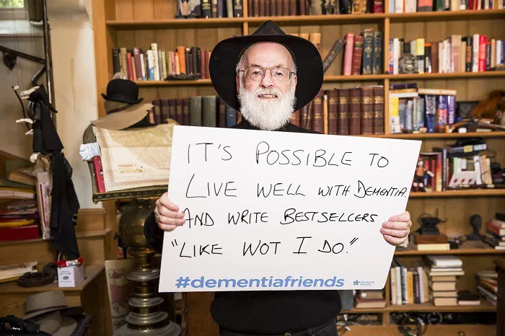
“What’s it all about? I mean really, when you get right down to it, what’s the point?” Terry Pratchett
Succeeding?
Making memories?
Leaving a legacy?

Slide 10
The Future
One thing we do know is that pure intellectual capacity is not enough to achieve this. You have to be willing to learn to create the dynamic process of change.
It is failure that creates change; redrafting and discussion is where progress happens.

Slide 11
What do the top Universities say?
The head of admissions at Oxford University told me they want people who:
Think independently i.e. don’t just repeat what they’ve been told.
Use existing knowledge to assess (not solve) new problems.
Work through difficult issues using dialogue.
Be curious enough about their chosen area of interest to do independent research.

Slide 12
How will we deal with this at Burton Borough?
Together.
By providing students with ways to experience things they may have never thought about before.
By giving students plenty of chances to develop their creativity.
By providing students with a range of opportunities to make mistakes and get things wrong.

Slide 13
THE BBU
Last year we established the Burton Borough University
This works alongside other basic expectations for high potential students.
@BBSUniversity

Slide 15
The Big Think!
Here’s the first Big Think question of the new academic year. For those of you who haven’t entered before, what stopped you? These are important questions and it’s a great opportunity to get your ideas out there!
Entries to Mr. Allen in comms 5 by Monday 24th of September.
Your position paper should state your opinion on the question and explain why you think what you think. The best submissions will give a range of reasons and evidence that indicate thoughtful research.
Which small school will get the most entries?
Which small school can prove they are the BIG thinkers?

Slide 16
The Future
@BBSUniversity
As your child progresses through the school we will have a range of other opportunities for them to explore their potential and their interests:
All years – Film Club, Big Think, Strategy Games, Theatre Trips
Year 7 and 8 – Thinking Skills
Year 8 – Carnegie Award shadowing, Young Journalists club
Year 9 – Mock Trial (in association with UWE)
Year 9 and 10 – Critical Thinking
Year 10 and 11 – SmartLaw mock trial competition
This is a list that is continuously evolving and improving.

Slide 17
Communication
@BBSUniversity
The school will make contact with parents and carers after the initial identification process for year 7.
The school website enables access to the school policy for high potential students, provides information on the current BBU courses and offers advice on how to support you child.
Look out for upcoming letters, emails and tweets regarding the Burton Borough University, these will include information about dates and opportunities.

Slide 18
Burton Borough

Slide 19
Mathematics Department KS3
Mixed ability classes Y7
High expectations – demanding curriculum as all schemes lead to higher or foundation tiers
Informal class assessments at the end of topics
Four formal assessments a year
Homework is set weekly – consolidate classwork, extend understanding, revision for an assessment, pre-learning and independent work on problem solving.
Homework Club– Wednesday 3.15 p.m. to 4.15 p.m.
Correct equipment – CALCULATOR

Slide 20
Burton Borough

Slide 21
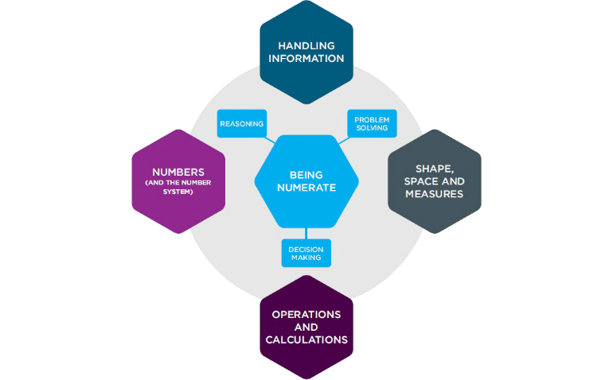
Numeracy at Key Stage 3
Whole School Numeracy Lead
julia.pickering@taw.org.uk

Slide 22
Numeracy at Key Stage 3
Numeracy policy designed to:
• Improve standards in numeracy across the school
Year 7 catch-up sessions for eligible students – details to follow
Numeracy activities in CLL time, and numeracy challenges and competitions throughout the year (Maths week, National Numeracy Day etc.)
KS3 maths revision (Wednesday evenings)
• Ensure consistency of practice including methods, vocabulary, notation, etc.
Interactive numeracy evenings 4-5 times per academic year for families (and students) to familiarise you with how we teach today
• Develop a positive perception of maths, and numeracy in particular, by empowering students with numeracy skills and fluency
Times tables practice

Slide 23
Numeracy at Key Stage 3
Top tips for parents and families:
Be positive about maths - Don't say things like "I can’t do maths" or "I hated maths at school"; your child might start to think like that themselves.
Point out the maths in everyday life - Include your child in activities involving maths such as shopping, cooking and travelling.
Praise your child for effort rather than talent - this shows them that by working hard they can always improve.
If you struggle with maths yourself - try out some of the resources at http://www.familymathstoolkit.org.uk/

Slide 24
Burton Borough

Slide 25
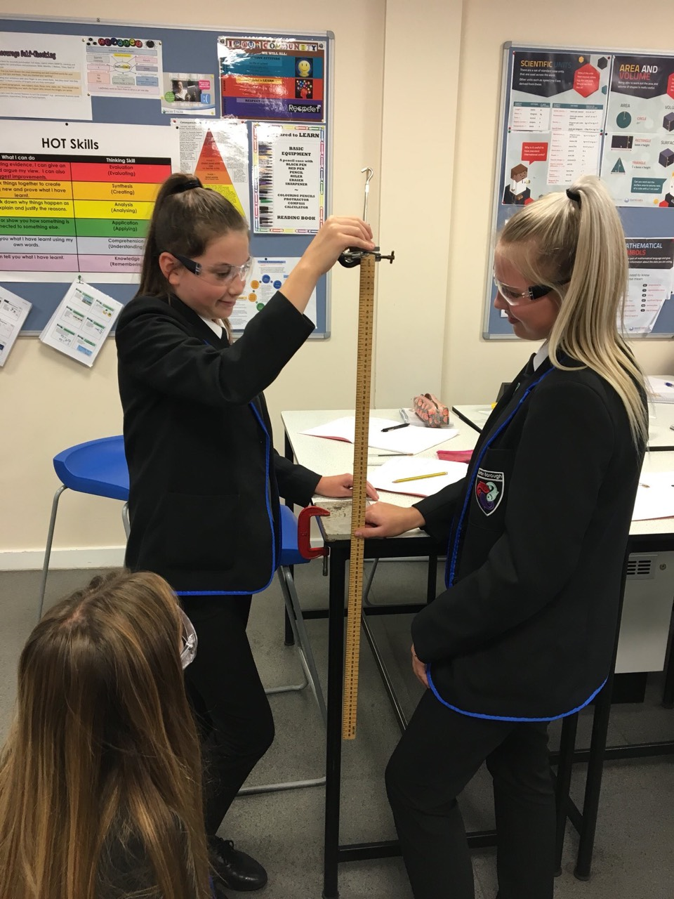
Year 7 Science
Three rotations throughout the year (based on Activate):
Rotation 1: Working Scientifically (All disciplines), Forces (Physics), Cells (Biology) and Particles and their Behaviour (Chemistry)
Rotation 2: Waves – Sound and Light (Physics), Structure and Function of Body Systems (Biology) and Elements. Atoms and Compounds (Chemistry).
Rotation 3: Space (Physics), Reproduction (Biology) and Reactions, Acids and Alkalis (Chemistry).
Teacher Assessment at the end of each topic – 50 minute test (GCSE Grade)

Slide 26
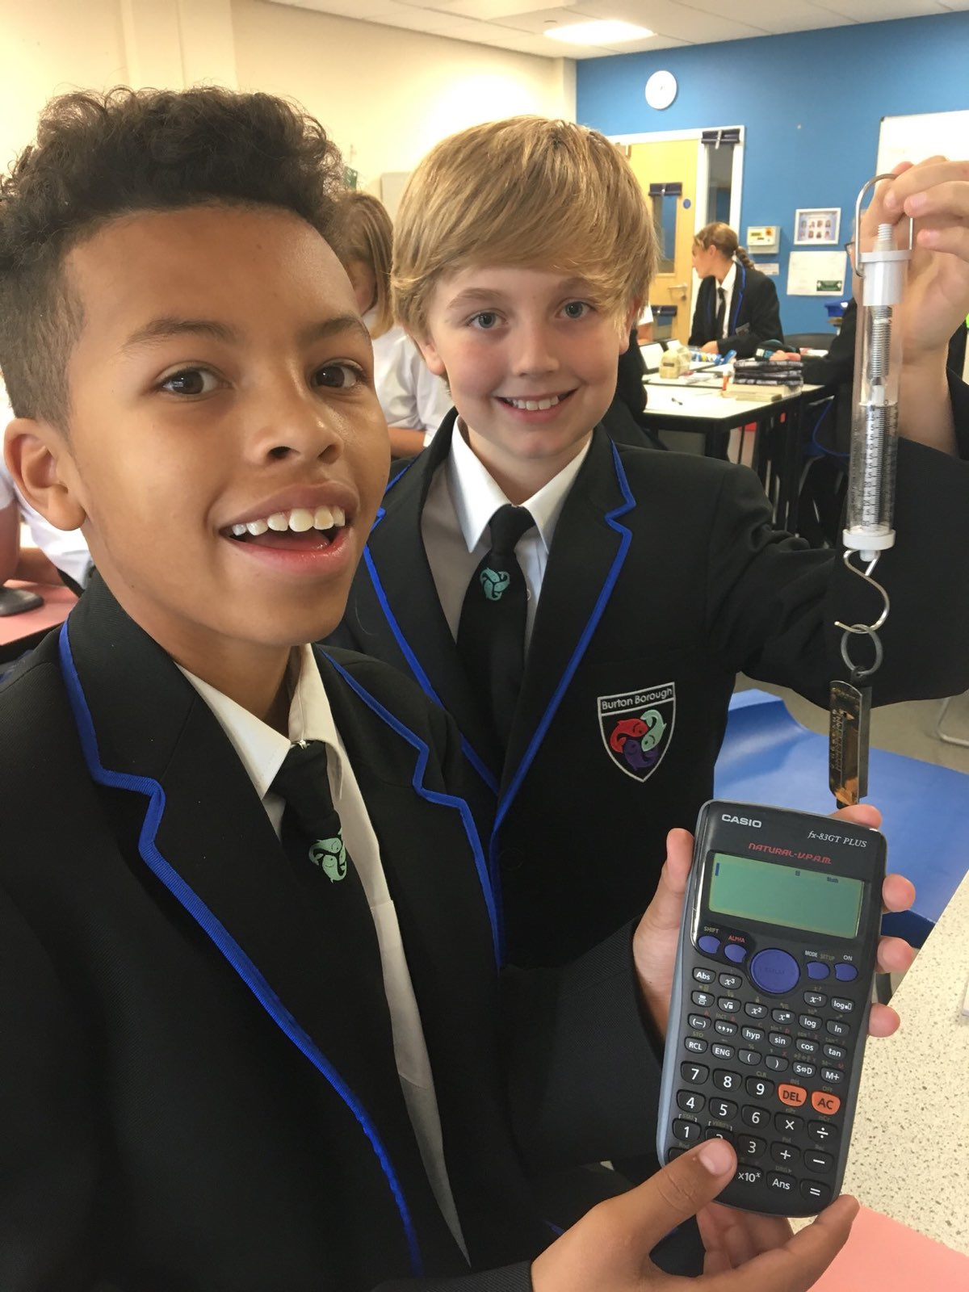
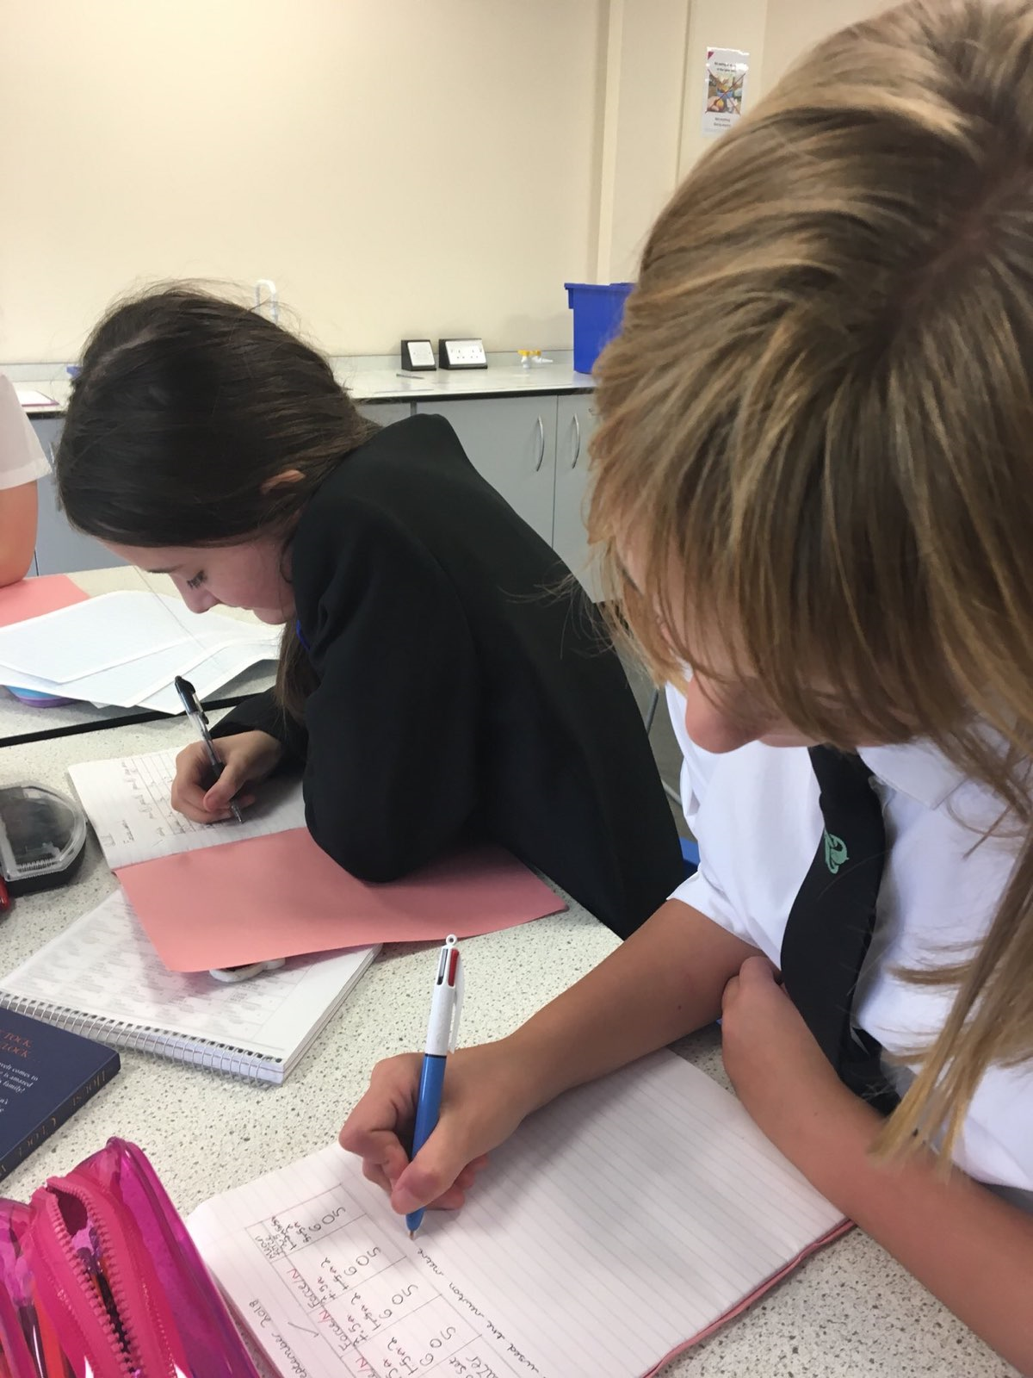
Twitter: BBS Science@science_bbs

Slide 27
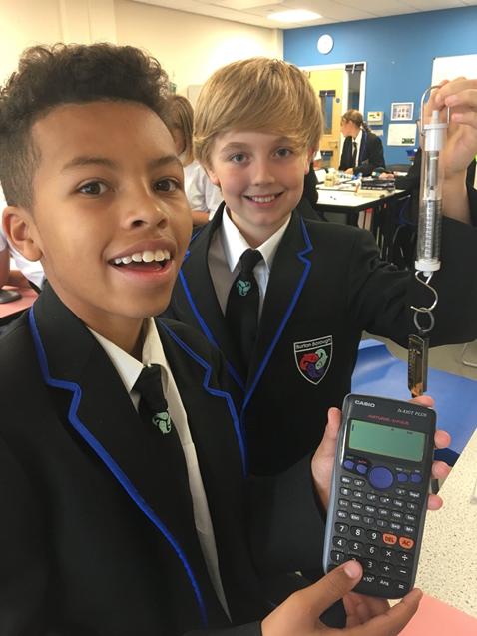
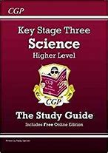
Recommended Equipment
CGP Key Stage Three Science Higher Level written by Paddy Gannon……..£3.50 each from the science technicians.
KS3 revision materials available online at: https://www.bbc.com/bitesize/subjects/zng4d2p
Scientific Calculator – from the maths department
30 cm ruler – for lines of best fit

Slide 28
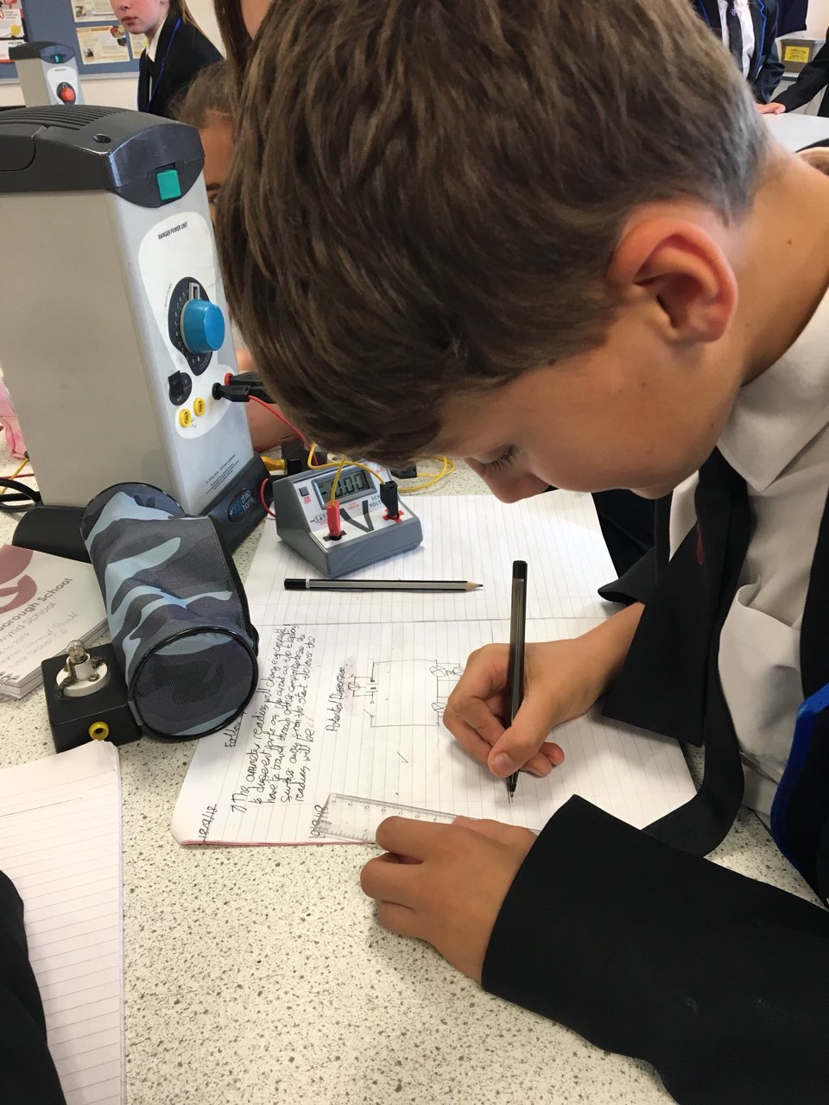
Homework
Purposeful – Consolidation, new learning or further challenge
Manageable – if not, please contact the subject teacher in the first instance
Developing skills – Thinking, literacy and numeracy
Sometimes involve the family – My Year 7 class should soon be explaining why ‘Weighing Scales’ measure mass, not weight.

Slide 29
Burton Borough

Slide 30
Literacy at Burton Borough School
‘The ability to read, write and verbally communicate effectively.’
Mr T. Dunbar – Whole School Literacy Lead

Slide 31
Why read for pleasure?
Studies into reading for pleasure have produced clear results which show that:
(1) A child will perform significantly better if s/he reads regularly for pleasure than those who do not.
(2) A study out last year concluded that those people who read regularly during adolescence have better vocabulary in later life.
(3) Have better communication skills.
Notes:
https://readingagency.org.uk/news/media/reading-for-pleasure-builds-empathy-and-improves-wellbeing-research-from-the-reading-agency-finds.html

Slide 32
Why else?
The reading material, questions, information, etc. your child will have to access becomes increasingly difficult.
Notes:
https://readingagency.org.uk/news/media/reading-for-pleasure-builds-empathy-and-improves-wellbeing-research-from-the-reading-agency-finds.html

Slide 33
What is Accelerated Reader?
It helps us, you and your child to monitor independent reading practice through calculating your child’s reading age.
Provides reading age data that can be used to support your child further in lessons to help them access their lessons.
Provides opportunities for rewards through the book quizzes.
Notes:
https://readingagency.org.uk/news/media/reading-for-pleasure-builds-empathy-and-improves-wellbeing-research-from-the-reading-agency-finds.html

Slide 34
What is the ZPD?
The ZPD (zone of proximal development) indicates how difficult a book is to read.
Your child’s ZPD level is based on the number of characters per word, number of words per sentence and average grade level of the words in the text.
After taking the ‘Star Reading’ test, your child will be provided with a ZPD which will look something like: 5.1-7.0. Your child is encouraged to choose books that are between these numbers to encourage reading age growth.
Notes:
https://readingagency.org.uk/news/media/reading-for-pleasure-builds-empathy-and-improves-wellbeing-research-from-the-reading-agency-finds.html

Slide 35
Accelerated Reader Book Finder
You can find a guide to the system in the booklets provided to you.
Notes:
https://readingagency.org.uk/news/media/reading-for-pleasure-builds-empathy-and-improves-wellbeing-research-from-the-reading-agency-finds.html

Slide 36
Creating a reading culture.
Dedicated 20 minute reading session every day during school.
A paired reading scheme to provide extra support where required.
Form group and mini school competitions based on book withdrawals from the LRC.
Notes:
https://readingagency.org.uk/news/media/reading-for-pleasure-builds-empathy-and-improves-wellbeing-research-from-the-reading-agency-finds.html

Slide 37
How can you help?
Take an active interest in what your child is reading.
Listen to them read. Ask them questions about the book such as who is their favourite character, what might happen next etc.
Check – do they have their reading book in their school bag?
Be a reading role model – especially good to see fathers reading.
Notes:
https://readingagency.org.uk/news/media/reading-for-pleasure-builds-empathy-and-improves-wellbeing-research-from-the-reading-agency-finds.html

Slide 38
What are we doing?
Accelerated Reader.
Embedding reading across KS3 in CLL and lessons to encourage students to read.
Rewarding students for reading monitoring book withdrawals from the LRC, providing more opportunities for inter-school competitions etc.
Catch-up for scaled scores under 100.
Developing writing skills so your children can plan, edit and redraft their work effectively.

Slide 39
Developing reading, writing, speaking and listening.
National Poetry Day –4th October 2018.
National Story Telling Week – 26th January 2019 to 2nd February 2019.
World Book Day – 7th March 2019.
No Pens Day – 17th May 2019

Slide 40
Burton Borough

Slide 41
Main aims:
Teaching and Learning at Burton Borough should enable student’s to be:
Independent
Interdependent (function in teams)
Think
Lead
Value other perspectives
Communicate effectively
Resilient
Engaged

Slide 42
HOT skills
Extended writing

Slide 43
Feedback – live marking
Stop students when you can see the error/when they stop themselves.
Intervene immediately
Allow opportunities to practice and secure the skill before moving on.
Model the correct technique so they can see what you expect.
Practice with them/alongside them.
Guide them to be able to independently practice.

Slide 44
Strategies within live marking:
The five-minute flick: check through a cross-section of books – five or six – to assess how students across a range of abilities performed in the lesson.
Modelling: showan example from one student – typed up or photographed – and critique it together.
Gallery critique: students move around the classroom critiquing one another's work with a plentiful supply of post-it notes. Not only do students receive detailed feedback from a number of peers, they also learn from reading each other's work.
Face to face: As the students are working, call them up one-by-one to the desk. Discuss their work and feedback both verbally and with symbols.
Yellow box: Students decide which part of their work they would like you to feedback on by drawing a yellow box around it.
Sign in sheet: Students can sign up throughout the lesson/on entry if they’d like the book looked at.
RAG trays: Students allocate their books to a tray on exiting the lesson. Those books in the red tray get reviewed by the teacher.

Slide 45
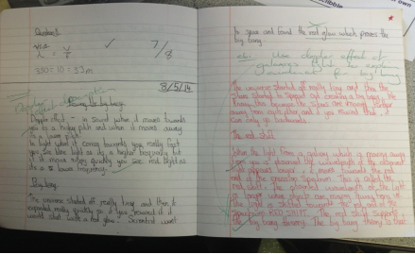
In summary:
There should be more red pen feedback than green pen feedback.
Students engage in the feedback there and then.
The feedback is relevant and immediate; the best time to ensure change is when they are thinking.
The feedback is given at the point it is usually needed most – when the student is working.
The feedback is personal.
The feedback includes examples and models.
The feedback can be used to develop the whole class.
The feedback is appropriately differentiated.

Slide 46
What do we expect of our students?
Bring all the correct equipment, which includes:
blue/black pen
red pen
PSD
Ruler
Calculator
Reading book
Have all the correct books for the day’s lessons.
Enter the classroom in silence, stand silently behind their chairs and sit in the correct seating plan.
Begin activities immediately – the ‘thinking classroom’.
Challenge themselves to complete extension tasks, HOT skills questions.
Take an active role in the class, engaging in all learning activities.
Take ownership for their learning by engaging in live feedback with the teacher.

Slide 47
What can you expect from us?
Books are reviewed regularly alongside the student both verbally and written.
Reward points, positive notes and post cards home are used to celebrate successes.
Behaviour pyramid is followed clearly.
Lessons are challenging, engaging and promote resilient, independent learners.
Homework is set consistently and at an appropriate level of challenge.
Quality first teaching ensures all lessons can be accessed by all our students.

Slide 48
What can you do?
Encourage your children to read.
Support your children to check Show my homework and complete homework tasks.
Dinner time debate – discussion about current affairs.
Down time – quiet environment, relaxation, reflection.

Slide 49
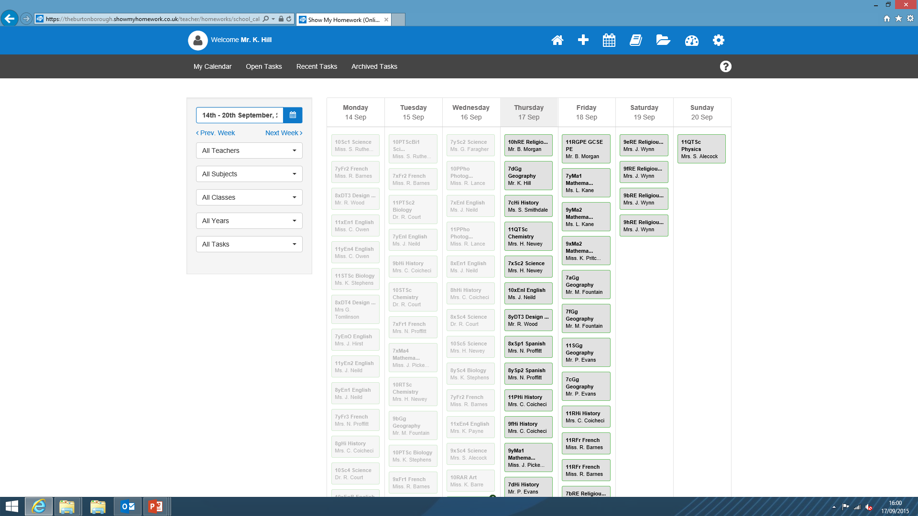
Apps available for Android and Apple devices
Parental logons Administrator : jake.blakeway@taw.org.uk

Slide 51
Extending and Enriching Learning at BBS
Kim Stephens

Slide 52
Current experiences programme
Fund raising
EEL days
Music
Drama
Sponsored walk
Sports day
assembly
Trips
Sports clubs
Kenya pen pal
SMSC
British Values
PIXL edge

Slide 53
Why are experiences important?
“Creativity: find it, promote it.”
QCA 2008
“We look for opportunities for children to build their knowledge, skills, understanding and personal development through leisure and enrichment activities.” Ofsted 2011
“Creative approaches to learning raise standards” Ofsted 2012
“Education of young people cannot simply be restricted to the teaching of academic subjects.” Paul Hamlyn, The Engaging School
“highly engaged students from poor backgrounds outperform disengaged wealthy students.”
OECD PISA 2009
Enrichment = making more meaningful, substantial or rewarding

Slide 54
What are EEL days?
Extending and Enriching Learning: a chance to immerse students in a subject whilst developing their skills and desire to learn more.
Recent activities have included:
St Johns Ambulance First Aid training
Author Visits
Mexican Day of the Dead Cultural experience
Enterprise Day
Visits to Mosques, Zoos, museums
External speakers including Exotic Zoo and Careers

Slide 55
So what would an EEL day look like?
THEME: FASHION (TO LINK WITH LONDON FASHION WEEK) across Y7-9
DT – visit from local fashion designer; designing outfit; creating outfits; photographing fashion show; link to English- photographing local fashion on the street and blogging about it.
Performing arts – work with local community to stage a fashion show. Clothes from local boutiques, money raised for our charities
Business and IT – marketing event; designing, printing and distributing leaflets; blog about event; visit from local print/marketing team
Science and maths – investigating cheap fashion v expensive brands – which lasts longer? Cost per wear. How much do you pay for a brand? Presentation on findings at fashion show.
Humanities and English – the impact of global fashion – write a newpaper article, letter to a big fashion brand, radio interview, highlighting concerns or fashion in Kenya – skype Makunga?; design a magazine spread
ALL STUDENT WORK THEN DISPLAYED AT THE FASHION SHOW

Slide 56
Communication home
EEL Day calendar and themes to be placed on school website and emailed home in December
Letter home 3 weeks prior to EEL Day
This will explain the activities that students will be involved in and the resources that they will need for the day
Some trips and activities may require a parental contribution if they are to run.

