Slide 1
GCSE History
EDEXCEL 1-9

Slide 2
Your Course
Your 4 periods of study!
Paper 1-
Thematic study. Crime and punishment through time, c1000-present and historic environment, Whitechapel and Jack the Ripper
Paper 2 –
Period study: Superpower relations and the Cold War, 1941-91
British depth study: Early Elizabethan England, 1558-88
Paper 3 –
Modern depth study: Weimar and Nazi Germany, 1918-39

Slide 3
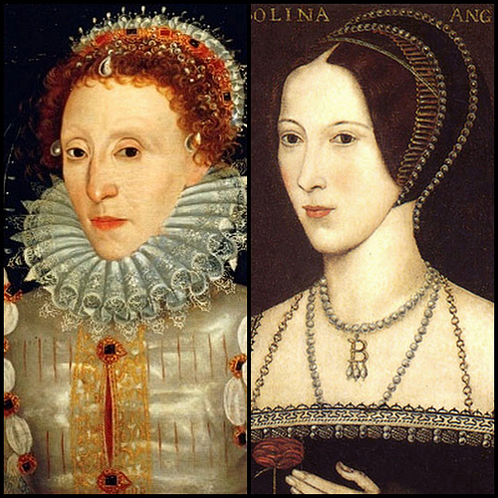
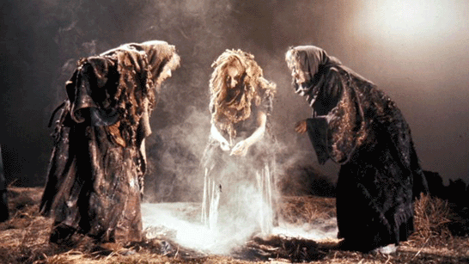
Year 9
Crime and punishment through time, c1000-present and historic environment, Whitechapel.
Early Elizabeth

Slide 4
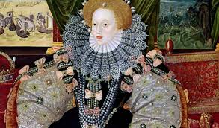
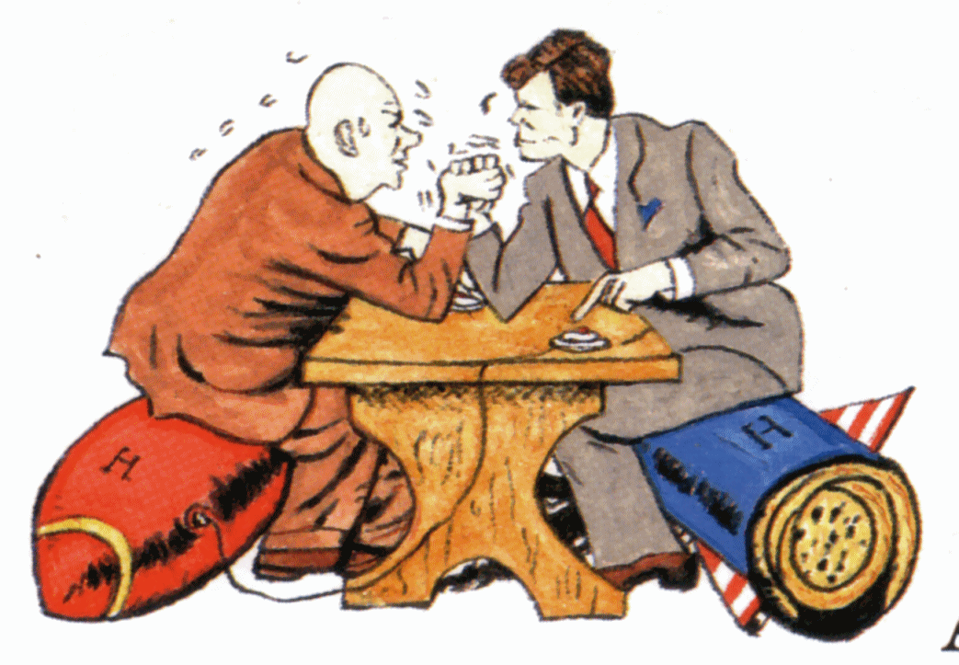
Year 10
Early Elizabeth
Superpower relations and the cold war, 1941-91

Slide 5
Year 11
Weimar and Nazi Germany, 1918-39
Revision and exam skills

Slide 6
Why study GCSE History?
History is fascinating. Studying it will feed your curiosity about
the world and help you to understand today's cultures and world
events through what you learn about the past.
Studying the subject will help you to develop valuable life skills,
such as analysis, evaluation and discussion, regardless of the path
you follow.

